Slide 1
Electronics & Electricity
Unit 6 – TinkerCAD Circuits
Section 2 – TinkerCAD Breadboards

Slide 2
TinkerCAD Breadboards
TinkerCAD Breadboards

Slide 3
The big idea
Familiarity with TinkerCAD Circuits
Designed circuits in a virtual environment
Circuit design both series and parallel
Virtual breadboard usage

Slide 4
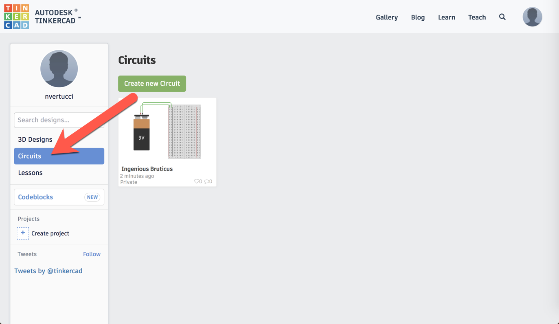
TinkerCAD Circuits

Slide 5
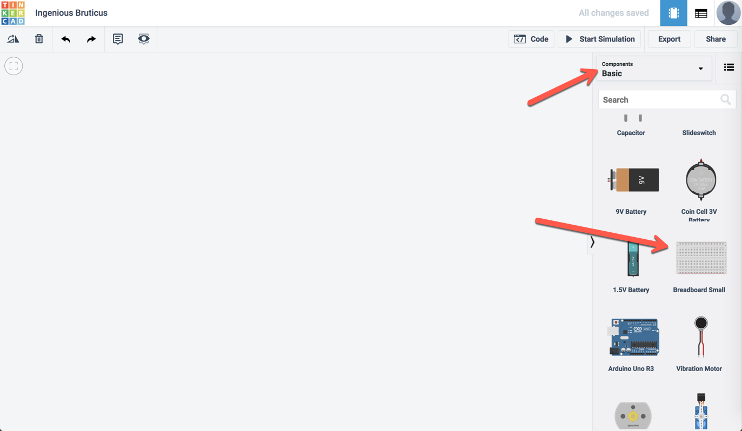

Slide 6
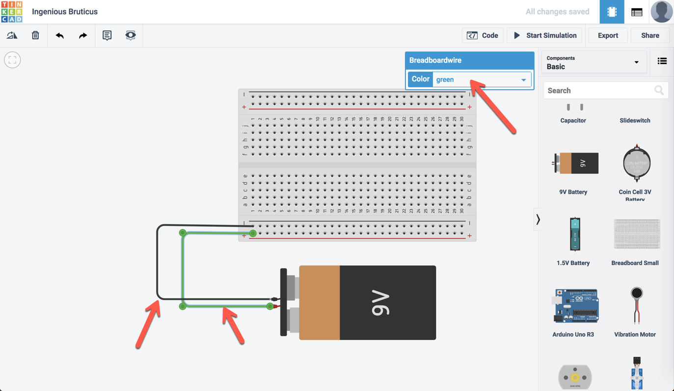

Slide 7
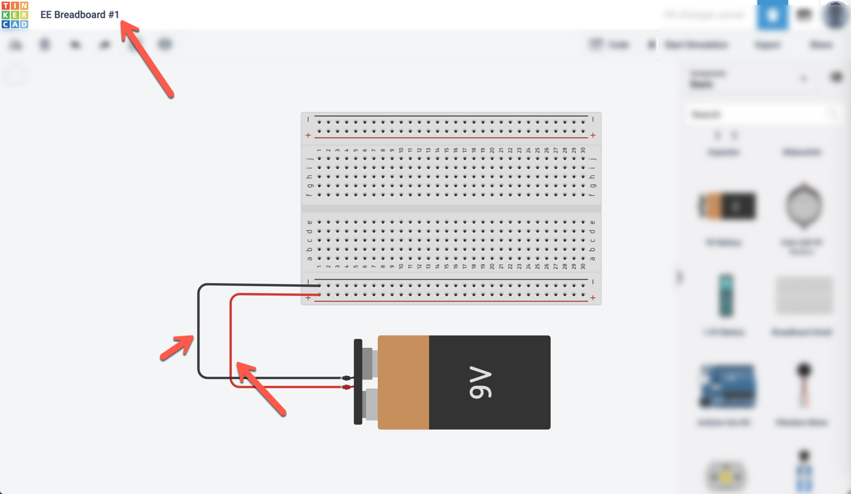

Slide 8
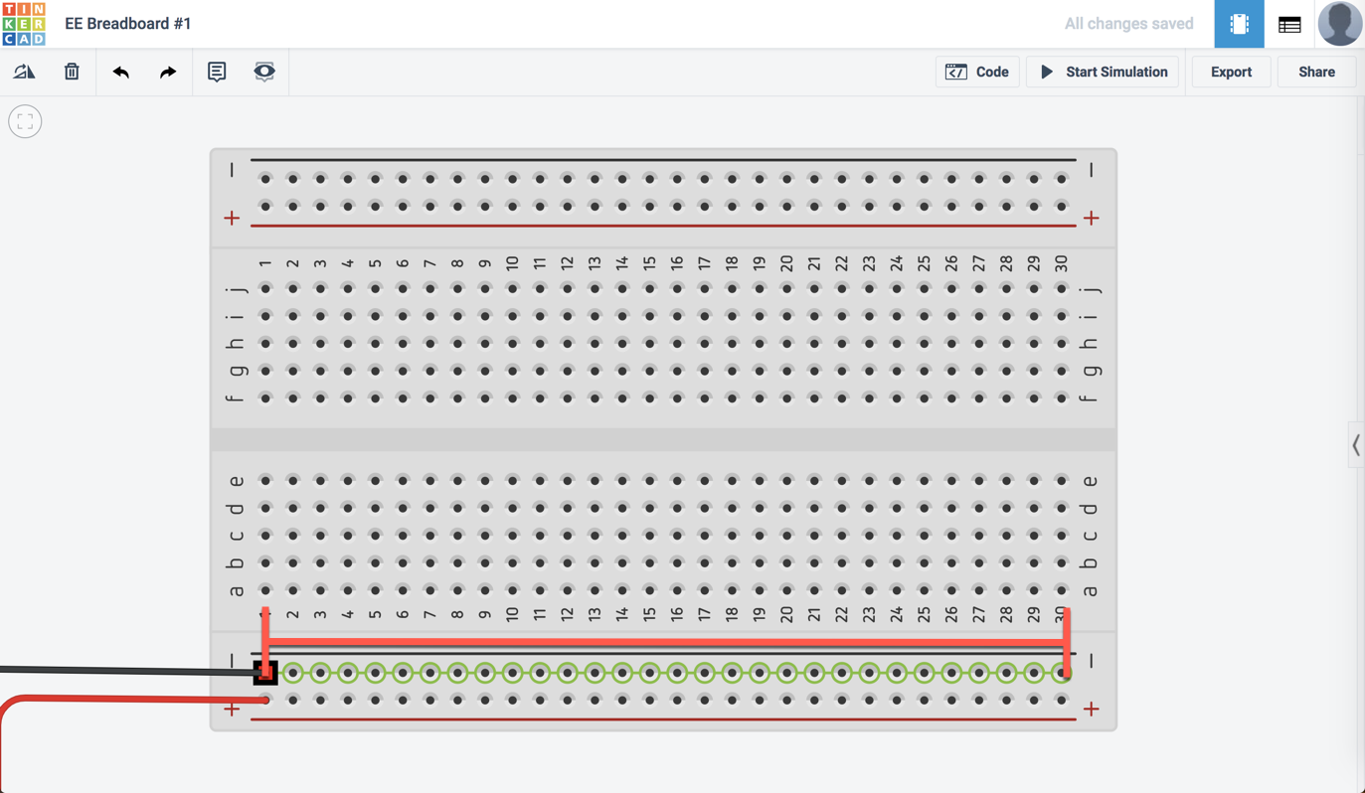

Slide 9
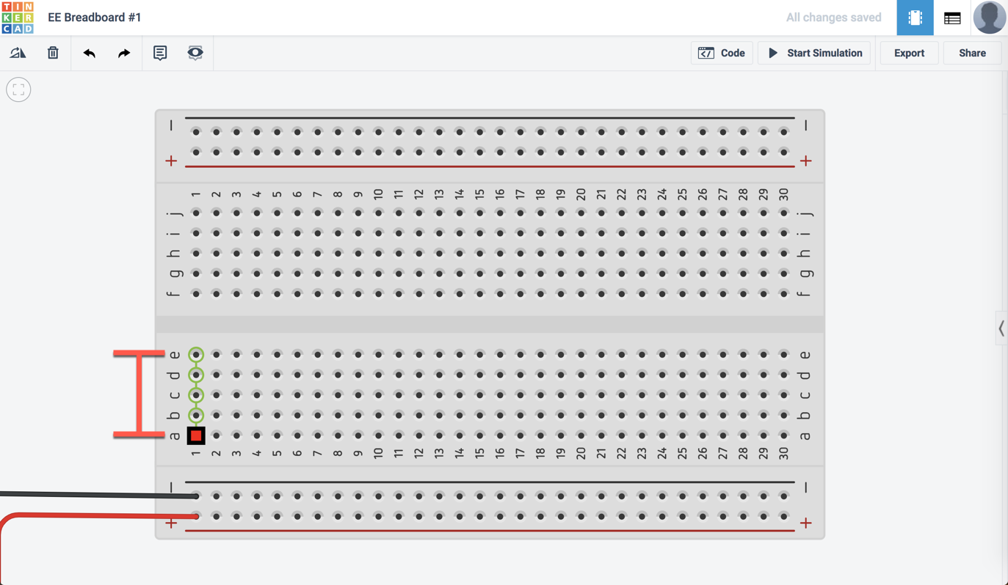

Slide 10
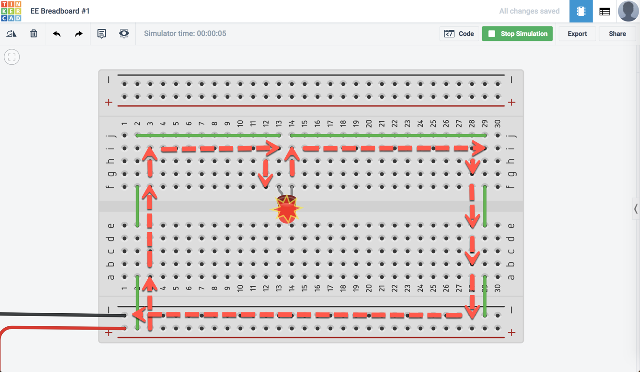

Slide 11
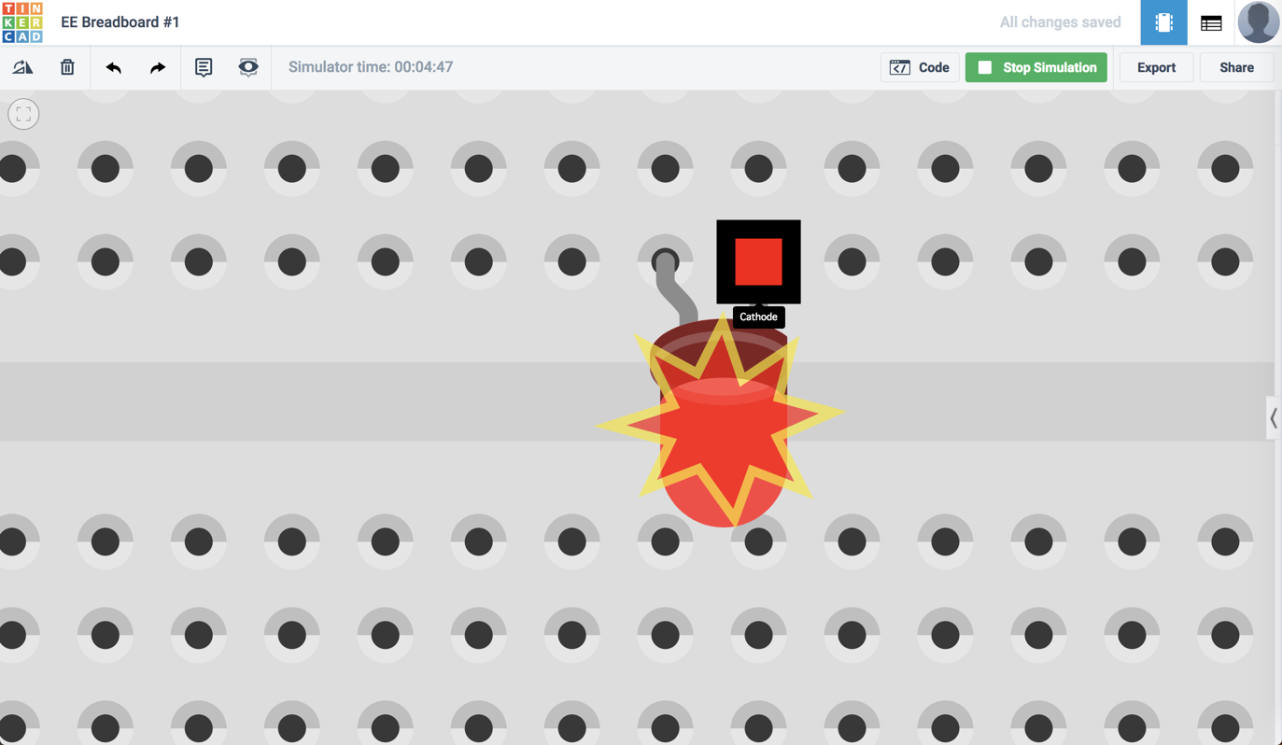

Slide 12
TinkerCAD EE#1
Requirements for TinkerCAD EE#1
Create a series circuit with a 9V source
Include a push button and a single (1) LED
Your series circuit should successfully light the LED when the push button is enabled

Slide 13
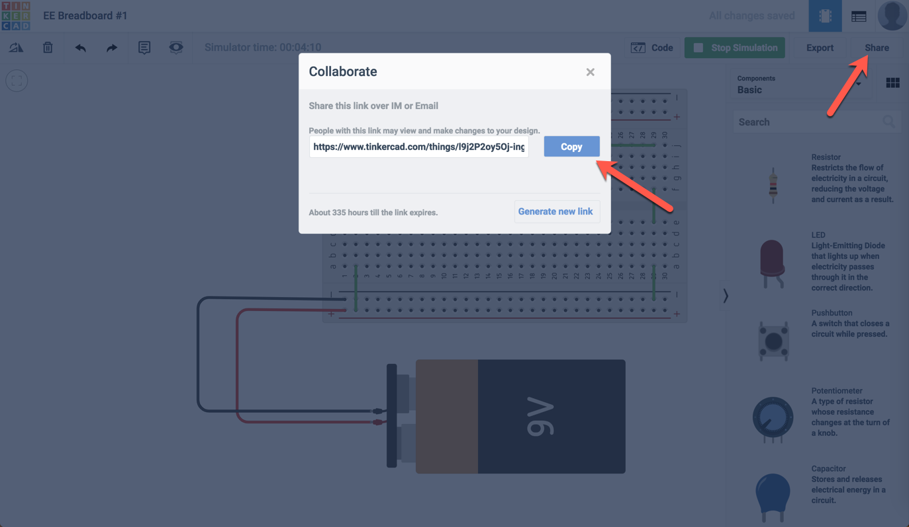

Slide 14
Workday Wednesday
Complete Electricity & Electronics #1 via TinkerCAD
Be sure to share the LINK when completing the Classroom assignment in the comments
BOTH group members must complete the assignment in Classroom

